Slide 1
Matrices with Numpy
Learning Objectives
Understand Matrix data structure
Use NumPy Arrays to build Matrices
Experiment with NumPy functions for Matrix variations
Expected Prior Knowledge
Python Basics, Python Arithmetic, Package loading

Slide 2
Fundamental package for scientific computing that supports multi-dimensional arrays
Offers efficient storage and processing of numerical arrays
Including advanced mathematical functions to operate on these structures.
In addition, it's capable in linear algebra, random number generation, and Fourier transform, to name a few
Numpy -Python package
Notes:
Pose question to class – can simplify to - whats a shared property between arrays and matrices?

Slide 3
Matrices

Slide 4
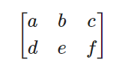
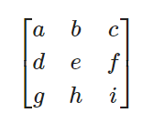


A mathematical construct which stores numerical values (elements) and follows an agreed set of rules.
Dimensions are given as Rows x Columns
2x3 Matrix:
Square Matrix:
What is a Matrix?
Column Matrix:
Row Matrix:
Notes:
Intuitive information, invite questions.
How is this different from a table? Elements must be numerical and is differentiated by its set of rules
It can also be viewed as a 2 dimensional numerical array

Slide 5
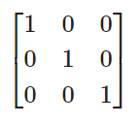
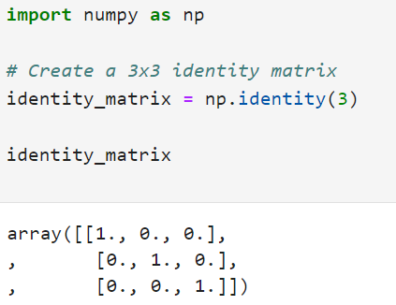
An identity matrix is square and has 1s on the leading diagonal, with 0s everywhere else:
In Python:
Using NumPy to create a 3x3 Identity Matrix

Slide 6
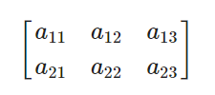
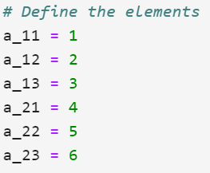

The array A is a 2x3 matrix and elements are usually named by using a lowercase letter and a subscript giving the row position then the column position:
A =
In Python:
Provide a list of rows when using NumPy array()
Matrix notation & allocating values
Notes:
Pose question to class – can simplify to - whats a shared property between arrays and matrices?

Slide 7
Use the following NumPy methods to create NumPy arrays:
np.identity(n) or np.eye(n), where n is the dimension of a square array.
np.array(). Create appropriate contents to produce an example of a column.
np.ones(n, m), where the dimension of the array is n x m.
np.empty(n, m)
np.arrange(start, exclusive_end, step). Use this to produce a row of values starting at 1, going up to but not including 15, in steps of 3.
np.linspace(start, end, no_of_values). Use this to produce 5 values that start at 0 and go up to 1.
np.random.rand(n,m) or np.random.randn(n,m). Use these to create an n x m array filled with random numbers between 0 and 1, or from the standard normal distribution.
np.full((n,m), value). Creates an n x m array filled with the value of your choice.
np.tile(base_array, number). Save one of your previous answers and explore how this method can be used to tile repeated copies of it as a single array.
Activity – Building arrays with numpy

Slide 8
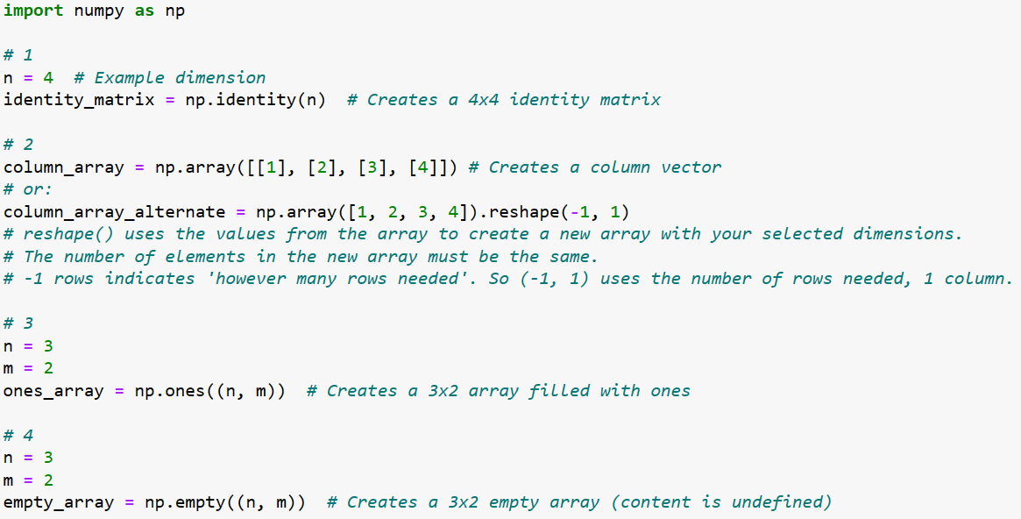
Solutions

Slide 9
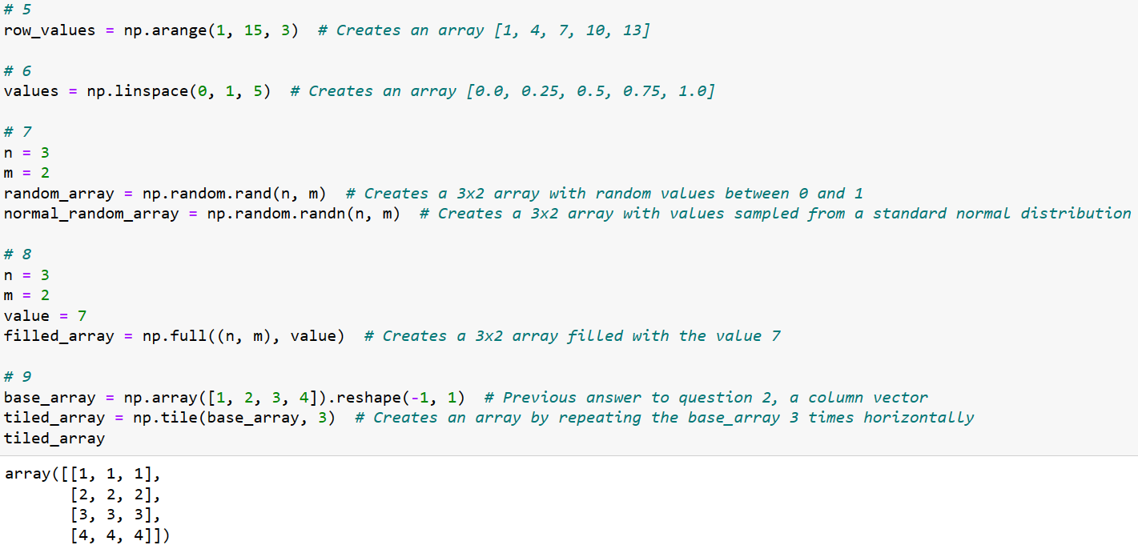
solutions

Slide 10
Learning check
Think about your answers to these questions:
Which of the NumPy functions we have used can create the most varied Matrices?
Why are we using NumPy Arrays to create Matrices?
In what ways are Matrices similar and different from Arrays?

Slide 11
How did you get on?
Learning Objectives
Understand Matrix data structure
Use NumPy Arrays to build Matrices
Experiment with NumPy functions for Matrix variations

